Slide 1
COVID-19: reflections from a national funder’s perspective
Dr Teresa Maguire
HRB GH Conference- 12 February 2021

Slide 2
You need to have close and good relationship with your funder and the decision makers/knowledge users You need to work well with other funders Wanting to respond will only take you so far. Much of a funder’s income is pre-committed on multiannual grants. Needed additional as well as re-directed funding- There is a residual opportunity cost
Need to be flexible and responsive

Slide 3
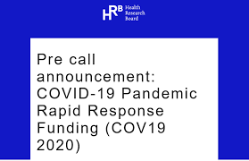

Slide 5
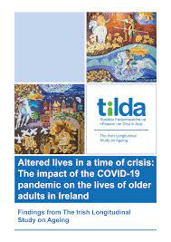

Slide 6
Trials of COVID-19 Treatments
DoH and HRB worked closely together- facilitated by prior HRB investment in CRFs and other supports
Ireland made a decision at the outset to invest public funding in large, multi-national, adaptive trials of Covid-19 treatments

Slide 7
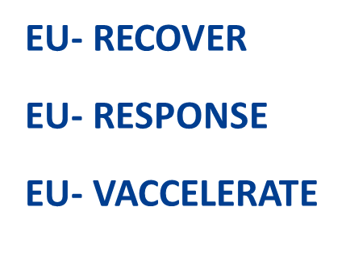

Slide 8
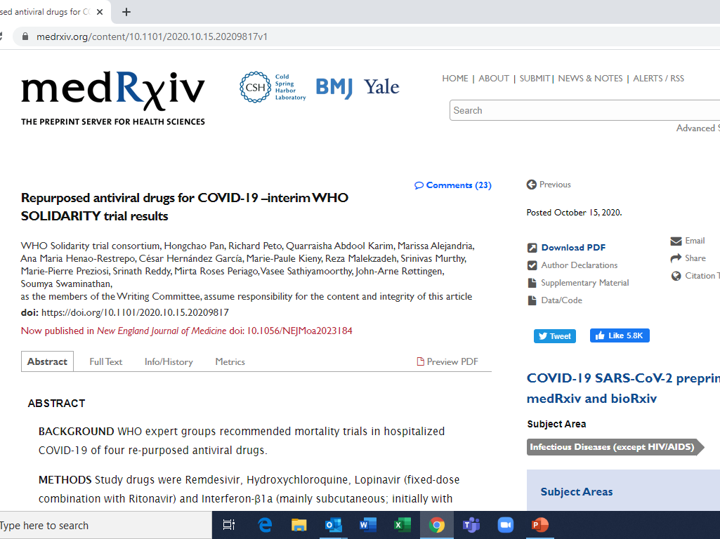

Slide 9
The Future is OPEN

Slide 10
Optimising the use of existing and rapidly evolving evidence and data

Slide 13
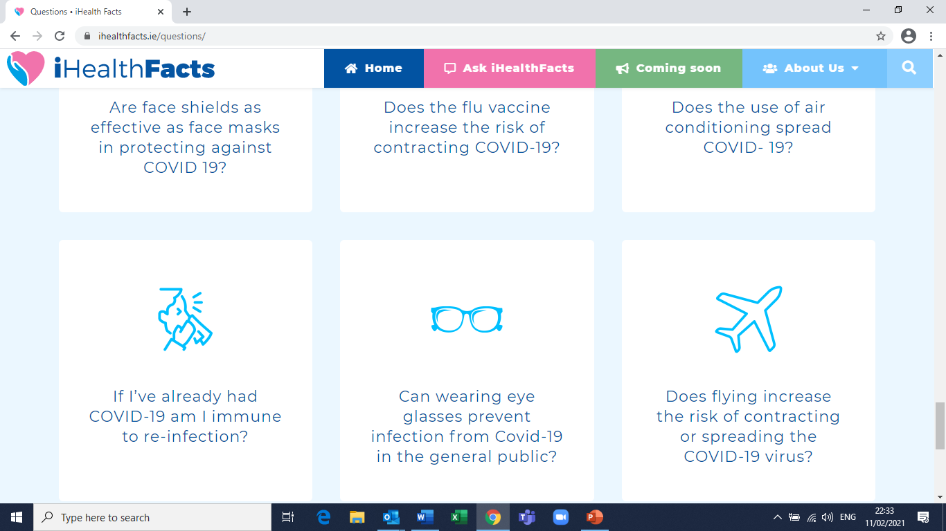
Misinformation, inaccurate medical advice, and conspiracy theories

Slide 14
Some current developments
National Covid-19 Biobank
Covid -19 data portal-collaboration with CSO to provide access for research purposes
Planning discussions underway about structured PhD training for public health modelling
Participation in PHIRI-Covid (Population Health Information Research Infrastructure)

Slide 15
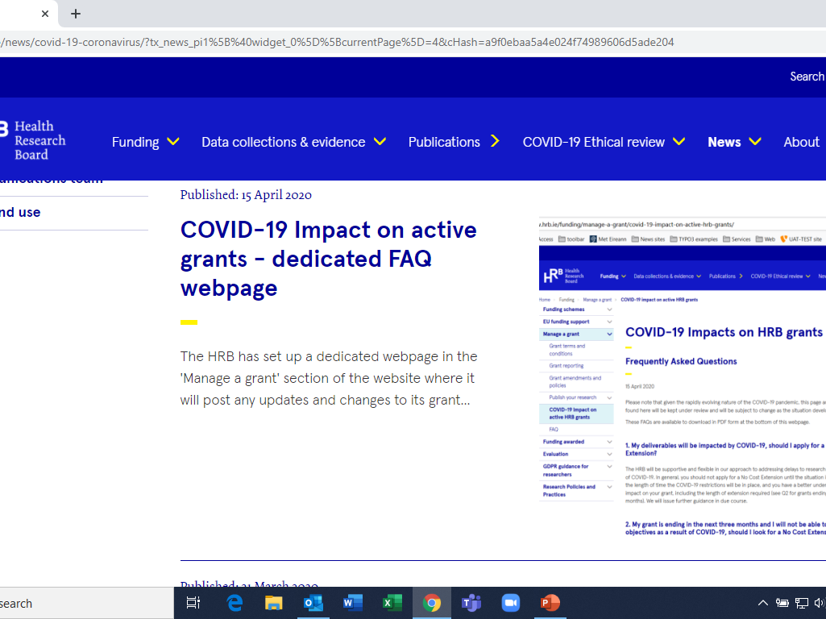

Slide 16
Funding models of the future
Increasing importance of transdisciplinary and internationally collaborative research
How can we fund/contract in a way that facilitates flexibility and an ability to chase opportunities as they arise organically
As a funder, do you wait for what emerges of do we become more directive, as required- to take positions on things in times where there is an urgent need?
What can we learn from rapid response calls?

Slide 17
Covid-19 exposed and exacerbated existing flaws in our health research system
Areas of under-investment came back to bite
Biobanking
access to data
public health capacity
Little/no additional funding - largely reliant on redirecting funds or the estimates process of following year
Government Lead for research coordination?

Slide 18
The research community mobilised and …is still responding!
Information gaps and evidence needs persist…….
Pandemic requires solidarity, collaboration and coordination
The future is OPEN
Dialogue with the public about health research is more important than ever…… & tackling misinformation
We will prioritise continued flexibility for all grant holders (and welcome the HEA fund)
Public investment in R&I needs to be prioritised

