Slide 1
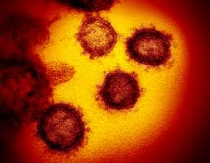
THE CHALLENGES OF RUNNING A RANDOMISED DRUG TRIAL IN PREGNANCY DURING THE COVID-19 PANDEMIC
Prof Fionnuala Breathnach MD FRCOG FRCPI DCH DipGUMed MSc
Associate Professor Obstetrics and Gynaecology, RCSI Rotunda Hospital Dublin
Network Lead for HRB-Mother and Baby Clinical Trials Network

Slide 2
Investigating the role of early low-dose aspirin in diabetes: A phase III multicentre double-blinded placebo-controlled randomised trial of low-dose aspirin initiated in the first trimester of diabetes pregnancy
HRB DIFA 2017

Slide 3
HRB-MBCTN Network Partners

Slide 4
Timeline
Nov 2014
HPRA approval for pilot
Ethics approval for pilot
Mar 2015
June 2015
CTA for pilot completed
Pilot recruitment began
Confirmation of sponsorship for Main RCT from RCSI
Jun 2016
Jul 2016
DIFA application submitted
Feedback to reviewers on submitted DIFA
Nov 2016
Dec 2016
Last Patient Last Visit for Pilot

Slide 5
Timeline
Mar 2017
DIFA Grant awarded
Start of RCSI sponsorship Office involvement
Jul 2017
Aug 2017
Grant Contract with HRB signed
Pilot Data MD submitted
Nov 2017
HPRA approval for main study
Ethics approval for main study
Issue raised by RCSI over indemnity - change in sponsor required
June 2018
Notification to HRB of change in sponsor from RCSI to Rotunda
Jan 2019
May 2019
Approval by HRB of change in sponsor from RCSI to Rotunda

Slide 6
Timeline
Jun 2019
SCA approval for main study
Rotunda CTA signed
Aug 2019
Oct 2019
NMH CTA signed
OLOL CTA signed
Extension of SCA indemnity to university partners
Coombe CTA signed
Nov 2019
23 Dec 2019
First patient recruited
Galway CTA signed
May 2020
Aug 2020
Cork CTA signed
Limerick CTA signed - TBA

Slide 7
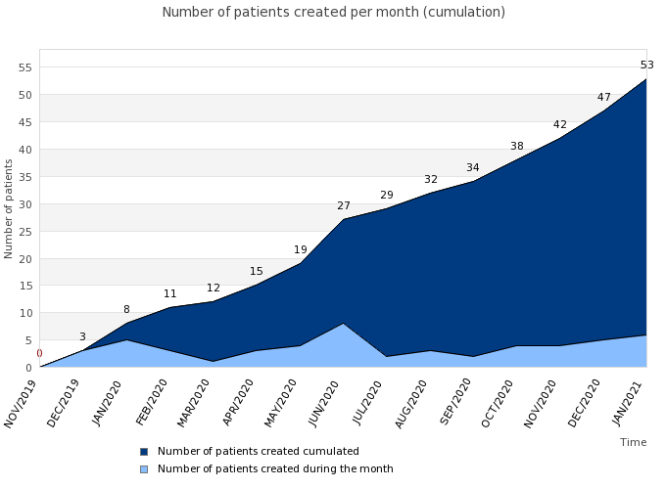
RECRUITMENT
-Target 360 over 36 months
-To date 53 in 12 months
-6th of 7 sites active since Jan 2021

Slide 8
COVID-19-related challenges & solutions
Challenges
Solutions
Dominance of Covid-19 in hospital setting
What CAN we do?

Slide 9
COVID-19-related challenges & solutions
Challenges
Solutions
Dominance of Covid-19 in hospital setting
Effect of pandemic effect on staffing:
-Working from home; Univ instructions
-Research staff seconded to Covid-related care
What CAN we do?
-Introductory Telephone consults
-Safety assessment for individual sites
-’Covid return to work on-line training module (hand-washing, C-19 precautions etc)

Slide 10
COVID-19-related challenges & solutions
Challenges
Solutions
Dominance of Covid-19 in hospital setting
Effect of pandemic effect on staffing:
-Working from home; Univ instructions
-Research staff seconded to Covid-related care
3. High-risk patient cohort: Reluctance to embark on pregnancy?
What CAN we do?
-Introductory Telephone consults
-Safety assessment for individual sites
-’Covid return to work on-line training module (hand-washing, C-19 precautions etc)
Time

Slide 11
COVID-19-related challenges & solutions
Challenges
Solutions
Dominance of Covid-19 in hospital setting
Effect of pandemic effect on staffing:
-Working from home; Univ instructions
-Research staff seconded to Covid-related care
3. High-risk patient cohort: Reluctance to embark on pregnancy?
4. Risk assessment: Avoidance of research-only hospital visits
What CAN we do?
-Introductory Telephone consults
-Safety assessment for individual sites
-’Covid return to work on-line training module (hand-washing; C-19 precautions etc)
Time
All research assessments aligned with clinically-indicated visits
Rationalisation of some study assessments & Pharmacy visits

Slide 12
COVID-19-related challenges & solutions
Challenges
Solutions
Dominance of Covid-19 in hospital setting
Effect of pandemic effect on staffing:
-Working from home; Univ instructions
-Research staff seconded to Covid-related care
3. High-risk patient cohort: Reluctance to embark on pregnancy?
4. Risk assessment: Avoidance of research-only hospital visits
5. Monitoring
What CAN we do?
-Introductory Telephone consults
-Safety assessment for individual sites
-’Covid return to work on-line training module (hand-washing; C-19 precautions etc)
Time
All research assessments aligned with clinically-indicated visits
Rationalisation of some study assessments
Monitoring: Not HSE employees; MOU allows Univ employees to access patient records on site, but not remotely. Hosp will allow Univ employees to attend hosp but univ will not

Slide 13
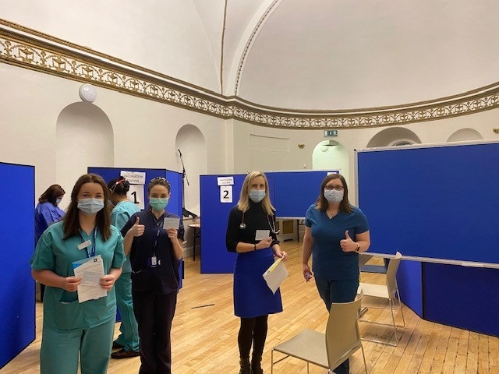
Thank you
fbreathnach@rcsi.com

