Slide 1
Emerging Investigator Awards for Health 2019
HRB Workshop
Dr Annalisa Montesanti, PhD
Programme Manager
Health Research Career

Slide 2
Emerging Investigator Awards for Health 2019
Supporting new independent investigators who can facilitate actionable knowledge in health research
Notes:
Comprises a number of schemes including co-funding of research under the SFI-HRB WT Partnership, MRCG-HRB Joint Funding Scheme, US Ireland R+D Partnership scheme and some of our funding through European Joint Programming Initiatives. The most recent to launch is our ILP: Investigator-Led Projects which replaces the Health Research Awards.
Interpret “health challenges” in its widest sense, including issues such as to understand better how to maintain and promote health and well-being, how to prevent or treat illness and how best to organise health systems.

Slide 3
Two calls planned during 2016-2020 strategy
2017 call with 11 awards made with €8.3m investment
2019 call with 7-8 awards expected with €5.3m investment

Slide 4
Contents
Objectives and career stage
Research Team
Funding
Highlights of the main changes
Application and assessment criteria
Timeline
Feedback from round 2017

Slide 5
1. EIA 2019 Objectives
The main objectives of this scheme are to:
Support talented individuals at a critical career transition stage to establish themselves as independent health investigators in an academic or other research-based institution.
Develop collaborative experts who can drive actionable knowledge by
translating knowledge generated through research into the health care system, policies or practice, or
generating research findings informed by policy and practice.
Notes:
Supported research should lead to improved visibility and standing for Ireland and Irish researchers.

Slide 6
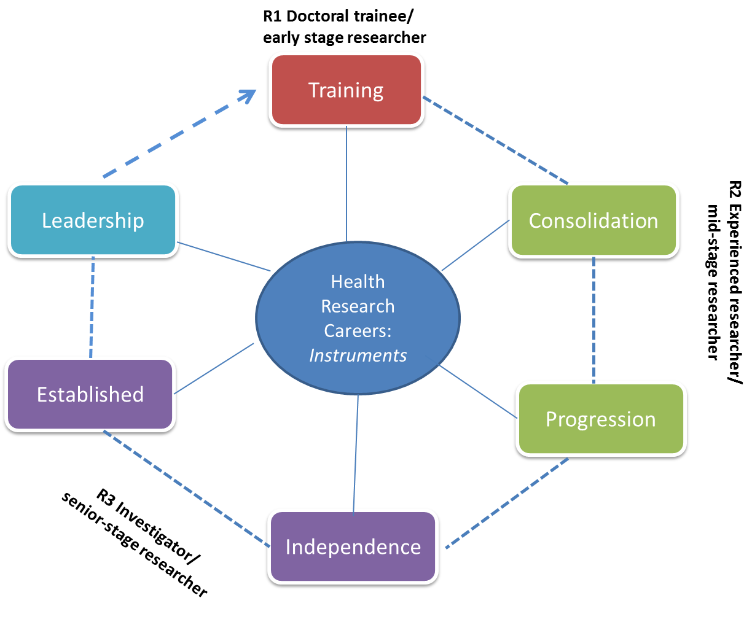

Slide 8
2. The Research Team
The proposal must have a team-based and collaborative approach:
The team must contain the necessary breadth and depth of expertise, skillset and methodologies
Must have appropriate cross-disciplinary and/or cross-border and/or inter-sectoral approaches as relevant to address the research question
The Lead Applicant must have a Mentor
Up to 5 Co-Applicants and 10 Collaborators
Notes:
The ILP designed to be complementary to two major funding schemes: DIFA, and APA.
The ILP scheme will not support interventions and feasibility studies for future interventions, as HRB now has a dedicated funding stream through DIFA scheme, which has been designed to determine the best proposed intervention and feasibility studies, through tailored guidance, application forms, review process and relevant expertise on the selection Committee.
New dedicated scheme and funding stream: APAs which are driven by national health and social care needs, where appropriate (national) knowledge users are integrated throughout the research process, and where in the APA scheme addressing a gap in the scientific knowledge base is not the primary aim of the research.
Note: applicants can apply in the same year for ILP, APA, DIFA etc – no restriction in this regard. However only one application per Lead Applicant in each scheme.
As per APA guidance notes: “one in a position of authority to influence and/or make decisions about health policy or the delivery of services and can act to ensure that the findings of the research will be translated to influence decision making and change within their (or other) organisations”
Furthermore

Slide 9
3. Funding
HRB estimates that there should be 7-8 awards in this round
It is expected that awards will typically be in the region of €600-700K inclusive of overheads -up to a maximum €800K if exceptional circumstances depending on the nature of the project and activities planned
Typical duration of 4 years – Full time or part-time arrangements can be requested
Budget must reflect the scale and nature of the proposed research
Salary of the emerging investigator
Salary for research personnel requested to carry out the project
Research related-costs (running costs, equipment, start-up, training, dissemination and FAIR data management)
Overheads

Slide 10
4. Main changes to the scheme
Application process
Review process
Eligibility of the Lead Applicant
Salary scale of the professionals applying for research protected time
Small revision on the scope
Data management/stewardship plans (DMP) - pilot

Slide 11
4.1 Application process
The EIA 2019 will use a two-stage application process consisting of:
Open call for Pre-application stage(Stage 1)
Panel review and shortlisting
Invitation of selected applicants to submit a Full Application (Stage 2)
Peer-review
Panel interview

Slide 12
4.2 Review process – elevator pitch video
Please record a two-minute elevator pitch video addressing why you are best suited as an HRB emerging investigator and how this award will support the achievement of your long term career goals.
This is a novel approach the HRB is piloting in this scheme aimed to corroborate the written statement in your personal declaration by including verbal communication from the Lead Applicant given the strong career development component in this scheme.

Slide 13
4.3 EIA 2017 - Eligibility for the Lead Applicant
Health-related researchers
generally engaged in full-time
academic activities
Professionals currently engaged in
practice-based roles or other health-related
professional roles who are also research-active
1. Have PhD or equivalent
(4 years active research experience): PhD must have been defended at least
in 2014
1. Have PhD or equivalent
(4 years active research experience): PhD must have been defended at least
in 2014
2. Have a minimum of 4 years
active postdoctoral research
experience
2. Have a minimum of 4 years of active research and professional experience
Notes:
Aligned with the expected international relevance of the proposed research. This is not intended to displace researchers based in Ireland, but to recognise that the Lead applicant should assemble the best team to tackle the research question, and that international collaboration can help to address the scale of many health challenges through integration of specific expertise, facilities. The international angle should also be addressed when it comes to dissemination plans – to ensure the results reach the widest, and most appropriate internationally.
Assessment criteria: excellence, originality and potential for impact have all been emphasised (see Scientific Quality and Relevance in assessment criteria). Threshold score for this. Track record will be taken into account as part of the feasibility of the proposed research.
Budget: increasing ancillary research costs that are becoming more commonplace within proposals such as: increased dissemination and PPI activities, eligible biobanking costs, biostatistics and research design support (e.g. from Clinical Research Facilities). Data management is an area that is growing in importance and will likely lead to additional costs in certain projects. Annual salary increments are payable in the ILP scheme. Note: cap on equipment costs has been increased. We do not expect more than 10k (inclusing VAT for equipment costs). The maximum funding envelope available is not an invitation to apply for the maximum amount.

Slide 14
The EIA call target mid-stage career researchers who are not recognised independent investigators.
Lead Applicants must not
Have received any substantial research grant funding as lead investigator/lead applicant with a value equal or above €100K. This would also include being work package leader on EC funding schemes.
and/or
Have already established a research team as an independent investigator (e.g. supervising and mentoring as primary supervisor early stage researchers, e.g. PhD candidates) ;
and/or
Be recognised in any other way as independent investigator by your institution.

Slide 15
Lead Applicants must not
hold a permanent academic position
hold fixed-term academic position with contract having an end date equal to or higher than two years from the deadline of this call (30 August 2018).
be recognised already as independent investigator
The following Lead Applicants are instead eligible to apply
Individuals who are employed in practice (e.g. health care professional employed by HSE) either with permanent or fixed-term non-academic long term positions.
Individuals who hold a fixed term post-doctoral or other research positions.

Slide 16
4.4 Salary scale for professionals
The salary scale for “professional” lead applicants who plan to continue working in-practice and want to apply for research protected time is increased to the IUA Senior Research scale (level 4 at max point 4).
For health-related researchers the max scale is still
Level 3 Point 4

Slide 17
4.5 Scope
The following types of applications are excluded from the scope of the EIA 2019
Applications that aim to conduct a stand-alone feasibility study for an intervention
Applications seeking to evaluate an intervention
Applicants can propose to develop an intervention, and may also include initial testing of the intervention in order to provide proof of concept data aimed to develop a feasibility study as next step (beyond this project).
Please refer to the DIFA scheme otherwise

Slide 18
Data Management Plans - Pilot
Outline of (FAIR) data management/stewardship plans will be asked in full application stage as well as data related costs (FAIR data management costs).
FAIR principles fully endorsed and FAIR data expected.
Work closely with Data support (Digital services and libraries) in HI.
Individuals awarded in main HEIs will have 3 months from start of award to complete and submit a full DMP.
More details will follow in the full application stage

Slide 19
5. Application Stage Pre-application stage and assessment criteria
Pre-application form will focus on (1) the track record of the Lead Applicant, (2) Details of the Research Team (Mentor and co-applicants) and (3) an outline of the research project focussing on the case for the research project and the potential for actionable knowledge.
The assessment criteria are:
The potential of the Lead Applicant to become an independent investigator;
Relevance of the research question and the potential for actionable knowledge;
Fit of the research team with the research question and the objective to drive actionable knowledge.
Notes:
The ILP designed to be complementary to two major funding schemes: DIFA, and APA.
The ILP scheme will not support interventions and feasibility studies for future interventions, as HRB now has a dedicated funding stream through DIFA scheme, which has been designed to determine the best proposed intervention and feasibility studies, through tailored guidance, application forms, review process and relevant expertise on the selection Committee.
New dedicated scheme and funding stream: APAs which are driven by national health and social care needs, where appropriate (national) knowledge users are integrated throughout the research process, and where in the APA scheme addressing a gap in the scientific knowledge base is not the primary aim of the research.
Note: applicants can apply in the same year for ILP, APA, DIFA etc – no restriction in this regard. However only one application per Lead Applicant in each scheme.
As per APA guidance notes: “one in a position of authority to influence and/or make decisions about health policy or the delivery of services and can act to ensure that the findings of the research will be translated to influence decision making and change within their (or other) organisations”
Furthermore

Slide 20
5. Application Stage Full Application stage and assessment criteria
The following assessment criteria will be used to assess applications by peer-reviewers and interview panel. Successful applications will be expected to rated highly in all criteria.
Potential of the Lead Applicant to become an independent investigator
Relevance of the research question and potential for actionable knowledge
Fit of the research team with the research question and the objective to create actionable knowledge
Appropriate research design and methodology to address the research question and create actionable knowledge
Host institution support during and beyond the award.
Notes:
The ILP designed to be complementary to two major funding schemes: DIFA, and APA.
The ILP scheme will not support interventions and feasibility studies for future interventions, as HRB now has a dedicated funding stream through DIFA scheme, which has been designed to determine the best proposed intervention and feasibility studies, through tailored guidance, application forms, review process and relevant expertise on the selection Committee.
New dedicated scheme and funding stream: APAs which are driven by national health and social care needs, where appropriate (national) knowledge users are integrated throughout the research process, and where in the APA scheme addressing a gap in the scientific knowledge base is not the primary aim of the research.
Note: applicants can apply in the same year for ILP, APA, DIFA etc – no restriction in this regard. However only one application per Lead Applicant in each scheme.
As per APA guidance notes: “one in a position of authority to influence and/or make decisions about health policy or the delivery of services and can act to ensure that the findings of the research will be translated to influence decision making and change within their (or other) organisations”
Furthermore

Slide 21
6. Host institutional support
No Letter of support required at Pre-Application stage.
The Letter of Support at full application stage must clearly describe how HI will support the Lead Applicant during the duration of the HRB award.
The Host Institution
Will recognise the successful Lead Applicant upon receipt of the award as an independent investigator, who will have an independent office, recognised new title, research space at the institution for which s/he will be fully responsible for at least the duration of the award.
Will sustain and support the successful Lead Applicant during the duration of the award by providing other support, such as access to infrastructure, mentoring and in-house training (e.g. leadership) and networking activities, etc.
There is a strong expectation that the Host Institution will extend support to the successful individual beyond the duration of this award with a full time or joint faculty appointment.

Slide 22
7. EIA 2019 - Timeline
Pre-Application Stage (Stage 1)
28 May 2018 | Call opening for Pre-Application stage
30 August 2018 | Deadline for Pre-application submissions
09 October 2018 | 1st Panel review and recommendations
Week of the 15 October 2018 | Notification to all applicants and invitation to full application stage for a selected number of applicants

Slide 23
Full Application Stage (Stage 2)
13 December 2018 | Submission of full applications
Late February 2019 | End of peer-review
Late-March 2019 | End of Interview panel review
End of March 2019 | Interview Panel Meeting
End of April 2019 | Board Approval & outcome notifications
May-July 2019 | Contract negotiation
August 2019 onwards | Start of the awards

Slide 24
Some info from 2017 call
Notes:
Comprises a number of schemes including co-funding of research under the SFI-HRB WT Partnership, MRCG-HRB Joint Funding Scheme, US Ireland R+D Partnership scheme and some of our funding through European Joint Programming Initiatives. The most recent to launch is our ILP: Investigator-Led Projects which replaces the Health Research Awards.
Interpret “health challenges” in its widest sense, including issues such as to understand better how to maintain and promote health and well-being, how to prevent or treat illness and how best to organise health systems.

Slide 25
2017 call
57 application received
56 eligible assessed
22 candidates invited to interview
11 awards made
Successful candidates by professions
Awards by HI
By type of researchers
Professions
Bioinformatics/statistics (Biostatistic) | 1
Health service Research | 1
Respiratory medicine | 1
Molecular and cellular biology | 1
Pharmacology | 1
Health economics | 1
Psychology | 2
Immunology | 1
Neurology/Neuroscience | 1
Neuroscience | 1
Total | 11
 | Eligible | Awarded
 | Tot N | Tot N
HCP- HPC full time academic | 12 | 2
Health R | 45 | 9
 | 57 | 11
Remit | N
POR | 6
PHHSR | 5

Slide 26
Panel feedback summary from 2017 call
Successful candidates at interview stage
were high calibre individuals
had clear vision of their career trajectory and their research programme
have shown good research productivity
have shown deep knowledge and understanding of the research field enabling them to embark in their research programmes as independent investigators
the research project had sound methodological approaches with only minor and addressable issues and
they had very good and complementary support team.
Notes:
Replacement, reduction and refinement of the use of animals in research. Not a large part of our funding portfolio, nonetheless we want to draw your attention to the need for sound justification for experiments involving pre-clinical research which involve animals. The guidance notes for the call gives further details as to what is considered in scope as pre-clinical and the need for justification of the model used.
Experiments should use the smallest possible number of animals required to answer the research question, and should ensure that distress and suffering are avoided wherever possible.

Slide 27
Panel feedback summary from 2017 cohort
Some pitfalls
Lack of strong research vision and/or career trajectory beyond the wish of becoming academic researchers. Inability to articulate a convincing research vision;
The candidate did not make a convincing case for why s/he should be given this prestigious award and gave the impression to apply for funding for the research project;
Leadership potential not sufficiently visible;
Lack of depth and broadness of their research methodology which is necessary for becoming an independent investigator;
Too many methodological flaws in the research project and/or was defined as not the most suitable project for the candidate at the time of transitioning towards independence;
Poorly designed project;
Lack of methodological breadth and insufficient mentoring, guidance and collaborative support to address this.
Notes:
Replacement, reduction and refinement of the use of animals in research. Not a large part of our funding portfolio, nonetheless we want to draw your attention to the need for sound justification for experiments involving pre-clinical research which involve animals. The guidance notes for the call gives further details as to what is considered in scope as pre-clinical and the need for justification of the model used.
Experiments should use the smallest possible number of animals required to answer the research question, and should ensure that distress and suffering are avoided wherever possible.

Slide 28
Thank you for listening
EIA 2019 team
PM – Dr Annalisa Montesanti amontesanti@hrb.ie
PO – Dr Louise Bryce lbryce@hrb.ie
Intern – Dr Helen Kennelly hkennelly@hrb.ie
Notes:
Version 1 of the FAQs are on the website – please do send in your queries and we will update this document if necessary as the call progresses

