Slide 1
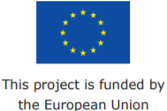
Joint Action on Market Surveillance of medical devices (JAMS)
Nicola Hickie, Health Products Regulatory Authority (HPRA)
Information Day – EU Commission Public Health Programme
13th June 2019

Slide 2
General Project Objectives
Reinforce market surveillance systems in improving the coordination of activities by all European Member States
Prevention of the occurrence of safety issues as a result of non-compliant product
Better protection of public health

Slide 3
Structure and Scope
3 administrative & 2 technical work packages
Work Package | Title | Lead Country
WP-1 | Project Coordination | FR
WP-2 | Dissemination of Information | FR
WP-3 | Evaluation of the Project | FR
WP-4 | Joint on-site inspections of Manufacturers | PT/FR
WP-5 | Clinical process and resources development | IE

Slide 4
Benefits
Common approach across the EU CA network
Optimising resource and expertise
Development of best practise
Improve oversight – effective monitoring
Coordinated activity - access to safe products
Increased awareness by stakeholders – system reputation/ confidence

Slide 5
Outputs
Development of systems & processes
Development of guidance
Development of training initiatives for authorities
Development of tools to assist in coordination
Communication initiatives for stakeholders

Slide 6
What has been delivered?
‘General leaflet’ – stakeholders the aims of the Joint Action and their role in Market surveillance (WP2)
‘Website of the Joint Action’ (CAMD) - WP2
‘Proposal for Joint Inspections’ - including surveying and analysing current practice across 33 countries (WP4)
‘Recommendations on Communication’- 'harmonised process for coordination of high profile market surveillance issues’ (WP5)
‘Process for prioritisation of Common specifications (CS)’ - establishing a process for prioritisation of devices for CS development (WP5)
‘Stakeholder specific leaflets’ – Targeting Patients, Notified Bodies, Manufacturers and Healthcare professionals (WP 2)

Slide 7
Administrative Work Packages

Slide 8
Work Package 1: Coordination
Actions undertaken to manage the project. Especially in charge of the financial and budgetary management and monitoring the progress of the action
Deliverables:
Interim report
Final report
Participation of WP leaders

Slide 9
Work Package 2: Dissemination
Actions undertaken to ensure that the results and deliverables of the project will be made available to the target groups
Deliverables:
Leaflet
Website
Layman version
Participation of WP leaders

Slide 10
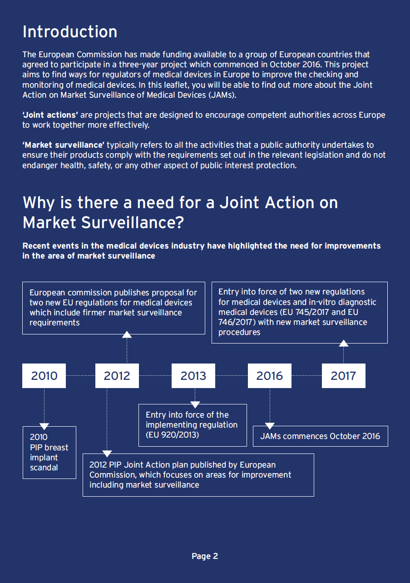
Engaging with Stakeholders
An important challenge of the Joint Action
Patients, Healthcare Professionals, Manufacturers, Notified Bodies

Slide 11
JAMS Press Release: CAMD website

Slide 12
Technical Work Packages

Slide 13
Approach
Call to CAMD
Survey
Solutions focussed
Workshops
Steer/ Strategy
Proposals
Process/ Matrix
Development
Notes:
Essentially there is a common approach adopted across the three key objectives of WP5 outlined here:
Questionnaire/ Survey – call to MS to identify the current state of play, current practices, challenges (of a telecoms nature or in terms of resource)
Workshops – must be solutions focussed. Identify together what might work best for the network – help identify the needs of the network (training, communication, clinical priorities) – look at addressing gaps and signals
Proposals – key recommendations – for comms platform; for a training strategy – common principles; alignment with work items of working groups/ JRC
Development – Process development for communication platform – identifying for various strands (high profile market issues, operational issues; communication with stakeholders – internal and external).
Development of resource matrix and expertise
Training modules, identification of devices to be prioritised.

Slide 14
JAMS-WP4: Joint On-site Inspections of Manufacturers

Slide 15
Participation
Beneficiaries (9) |  | Collaborating Partners (5)
Austria, AGES |  | Belgium, FAGG
Cyprus, CYMDA |  | Estonia, Terviseamet Health Board
France, ANSM |  | Latvia, VI
Ireland, HPRA |  | Norway, NOMA
Italy, DGDMF |  | UK, MHRA
Portugal, INFARMED
Spain, AEMPS
Sweden, MPA
The Netherlands, NLNA

Slide 16
Key Objectives
Identify and collect the national policies on planning inspections
Identify areas and candidates for sharing of expertise and best practise regarding manufacturer inspections
Identification and development of mechanisms to ensure market surveillance activities are harmonised. Collaborate planning and optimisation of resources where possible
Map specialist expertise across the system
Identify training needs and available expertise within the authority network

Slide 17
JAMS-WP4 Key Deliverables
D4.1
Proposals for Joint Inspections of Medical Device Manufacturers in Europe
D4.2
Guidance for Joint Inspection Initiation
D4.3
Establishment of Inspectors Training Course
D4.3
Establishment of Inspectors Expert Group
D4.4
- Guidance on Conduct of Joint Inspections
- Post Inspection Activities
Complete In-progress Future work

Slide 18
JAMS-WP5: Clinical Process & Resource Development

Slide 19
WP5 – Key objectives
Identify training & development needs for evaluation of clinical data
Establish communication platform and process for coordination and information exchange
Identify process to prioritise devices requiring Common Specifications

Slide 20
WP5 – Clinical Process & Resource Development
Beneficiaries (6) | Collaborating Stakeholders (7)
AGES (AT) | BfArM (DE)
ANSM (FR) | CYMDA (CY)
DGDMF (IT) | DKMA (DK)
HPRA (IE) | Halmed (HR)
INFARMED (PT) | AEMPS (ES)
NLNA (NL) | Terviseamet (EE)
 | MHRA (UK)

Slide 21
What has been delivered?
‘Coordination process for market surveillance’- harmonised process for coordination of high profile market surveillance issues
‘Process for prioritisation of Common specifications (CS)’ - establishing a process for prioritisation of devices for CS development
Training workshop for NextCoud Communications Platform
Workshop on Identifying clinical training needs; development of training strategy document
Development of process for expert engagement

Slide 22
CS Prioritisation Process
Prioritisation process developed
(+CIE WG)
Guidance &Template Documents drafted
Collation of existing guidance in other regulatory regions

Slide 23
Outputs

Slide 24
Integration with Communication platform
Communication Process on Coordination defined
Option identified for Communication Platform
Development of Pilot Portal

Slide 25
Clinical Training
workshop on clinical training needs
Strategy document developed
Training materials initiated
Final workshop Sep 19

Slide 26
WP5 status

Slide 27
Key Challenges

Slide 28
BREXIT & Resources
Transfer of the coordination role
Transfer of the WP4 lead role

Slide 29
Project related challenges
Issues relating to administration of the project
access and signoffs through portal
format of financial statements,
Scope of project, including duration, to include defined follow up actions once project complete for consistency
Estimating resource commitment

Slide 30
Acknowledgements
Consumers, Health, Agriculture and Food Executive Agency (CHAFEA)
France (ANSM)
Portugal (INFARMED)
UK (MHRA)
JAMS participants and all the EU countries that allowed to find a collective solution and continue the JAMS implementation activities (Ireland, Sweden, Austria…)

Slide 31
Thank You
Nicola.Hickie@hpra.ie

